Slide 1
Gases

Slide 2
Welcome to this lesson on gases! This Smart Lesson will teach you about gases in a little more detail. By the end of this lesson, you should be able to:
Recall that gases have a variable shape and volume.
Explain that particles of a gas have high energy and have no bonds connecting them.
Demonstrate your knowledge of particle behaviour and the physical properties of a gas.

Slide 3
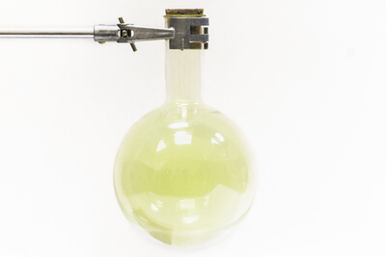
Gases have a variable shape.
This means that, like a liquid, they can change their shape to fit their container.

Slide 4

Gases also have a variable volume.
They are the only state of matter that can change their volume.
This means that when a gas is put into a different sized container, it will change the amount of space it occupies to fill that container.

Slide 5
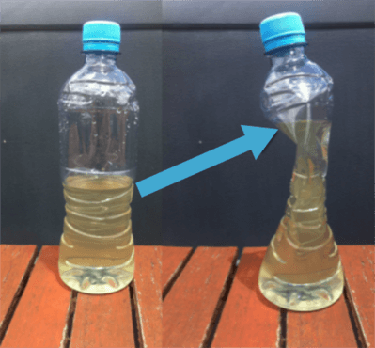
Gases have a variable volume which means they are compressible.
If you put a gas in a container and then squeeze the container, the gas will compress to occupy a smaller space (have a smaller volume).
In the picture below, someone has squashed a bottle. The top half of the bottle was filled with air (a gas). This gas compressed to fit in the smaller space.

Slide 6
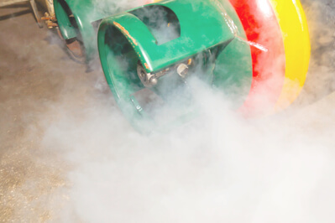
Gases are also expandable.
They will increase their volume to occupy a larger space.
In this picture, the gas escaping the tank expands as it enters the air. The gas will eventually expand to fill an area larger than the tank it was contained in.

Slide 7
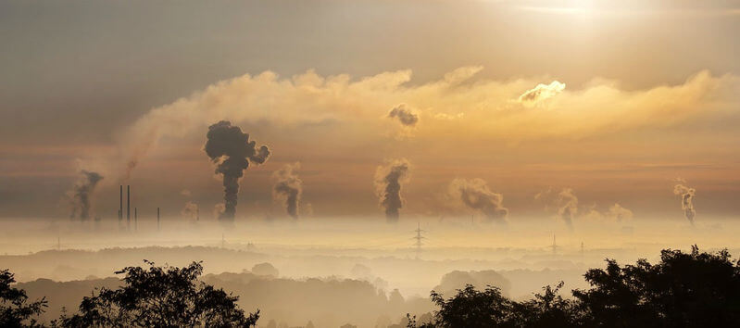
Most gases are invisible.
Often the gases we think we can see are actually made up of gases with solids or liquids mixed in.
For example, when you see smoke rising from the fire, what you are seeing is tiny pieces of ash that are caught up with the gases rising out of the fire.
This is also true of steam from a hot drink. What you can see are tiny droplets of liquid water that are suspended in the warm gas.

Slide 8
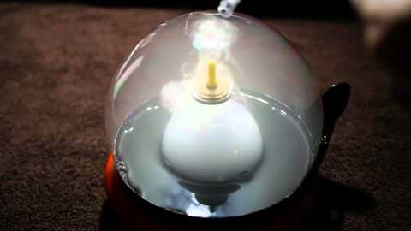
Watch this video (1:40) in which smoke expands as the size of its container changes. As each small bubble of smoke is added to a larger bubble, the smoke expands to fill the larger bubble.

Slide 9
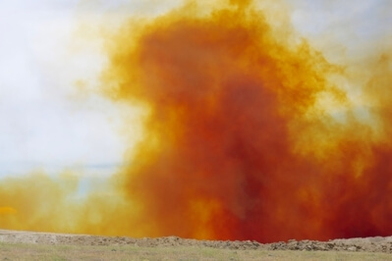
The particles of a gas behave in a particular way to give it a variable shape and volume.

Slide 10

The particles of a gas have very high energy.
The particles have enough energy to overcome the attractions between them.
The particles have so much energy that they break their bonds entirely! There are no bonds between the particles of a gas.

Slide 11

Gas particles are very far apart because they have no bonds holding them together.
They can expand: drift farther apart to occupy a larger space.
They can also be compressed: forced closer together to occupy a smaller space.
This is why gases have a variable volume.

Slide 12
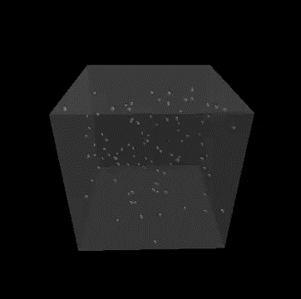
With no bonds holding the particles together, the particles of a gas can move around freely.
Like in a liquid, this results in a random and ever-changing arrangement of particles, which is why gases have a variable shape.
Gas particles will also move around quickly because they have so much energy.

Slide 13
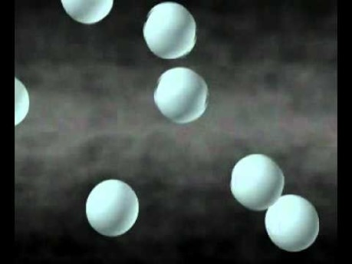
Watch this video (0:18) to revise what we have learnt about particles of a gas!

